Slide 1
Come in Quietly
Take out a pen or pencil

Slide 2
Objective: Evaluate the major debates, over representation, that occurred when writing the Constitution.
Objective
Standard 8.2.3: Evaluate the major debates that occurred during the development of the Constitution and their ultimate resolutions in such areas as shared power among institutions, divided state-federal power, slavery, the rights of individuals and states (later addressed by the addition of the Bill of Rights), and the status of American Indian nations under the commerce clause.
RH 8.7: Integrate visual information (e.g., in charts, graphs, photos, videos, or maps) with other information in print and digital texts.

Slide 3
Prior Knowledge:
You already know about the Articles of Confederation.
What was the biggest problem with the Articles of Confederation?

Slide 4
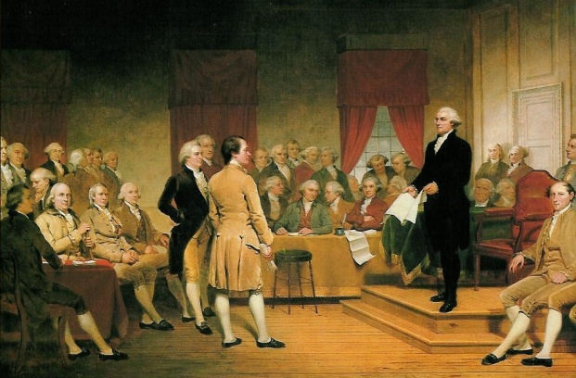
Government officials realized after Shays’ Rebellion that a change was needed.
The Second Constitutional Convention
A convention of representatives from each state were called to Philadelphia in 1787. 74 Men were invited to come to Philadelphia but only 55 delegates arrived.
Twelve states sent delegates, all but Rhode Island.
Delegates had a choice to make:
Fix the Articles of Confederation
2. Write a new plan for government
The delegates decided to write a new plan for government. The challenge was to create a strong national government but one that would still leave state governments some power.

Slide 5
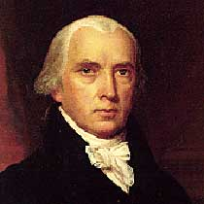
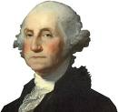
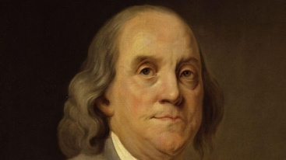
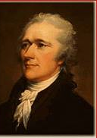
The Constitutional Convention Delegates
James Madison read as many books as he could find to prepare for the convention. He is known as the “Father of the Constitution” because of the detailed notes he took of the proceedings.
George Washington came out of retirement for the convention. Due to his leadership during the American Revolution he was chosen to be president of the convention.
Benjamin Franklin was the oldest delegate at age 81. He added his experience and sense of humor to the discussions and often helped keep arguments from getting out of control.
Alexander Hamilton a staunch supporter of a strong national government. He was Washington’s personal secretary during the American Revolution.

Slide 6
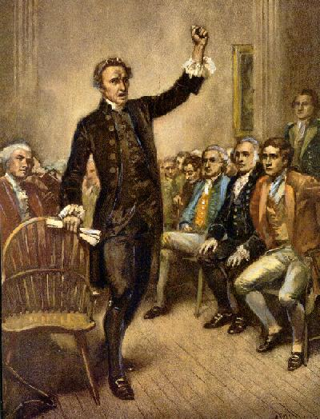
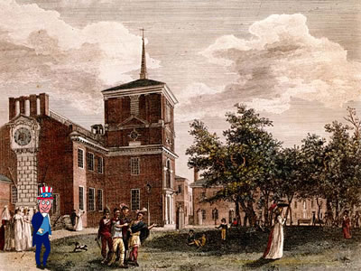
It was decided that the meetings during the Constitutional Convention would be kept secret so delegates could feel free to speak their minds without fear of outside interference.
Guards were posted at the doors and all the windows were closed. The men swore not to speak of the meetings with anyone but the other delegates.
Not everyone agreed with the secrecy. Some believed the discussions should be open to the public. But others believed that if word got out they were doing more than just fixing the Articles, they would never be allowed to create a stronger government.

Slide 7
Closure
What decision was made about the Constitutional Convention?
Who were some of the people at the Convention and who was missing?

Slide 8
Come in Quietly
Take out a pen or pencil
Take out chromebook (closed)
Take out Preamble Art

Slide 9
Objective: Evaluate the major debates, over representation, that occurred when writing the Constitution.
Objective
Standard 8.2.3: Evaluate the major debates that occurred during the development of the Constitution and their ultimate resolutions in such areas as shared power among institutions, divided state-federal power, slavery, the rights of individuals and states (later addressed by the addition of the Bill of Rights), and the status of American Indian nations under the commerce clause.
RH 8.7: Integrate visual information (e.g., in charts, graphs, photos, videos, or maps) with other information in print and digital texts.

Slide 10
Prior Knowledge:
You already why they held the Second Constitutional Convention.
How did they decide to conduct the convention (SHHH)?

Slide 11
Steps:
Read the text.
List the key facts about each plan on the Graphic Organizer.
Highlight similarities between the plans.
Skills
Virginia Plan | Great Compromise | New Jersey Plan
James Madison | Roger Sherman | William Patterson

Slide 12
The Virginia Plan
39. The Virginia Plan was written by James Madison. 40. It was written to replace the Articles of Confederation instead of revising them. 41. It proposed three branches of government (executive, judicial, and legislative) with a ‘checks and balances’ system to prevent abuses of power. 42. Madison believed that, although a stronger central government was necessary to defend against foreign invaders and to control the power of the states, it was also important to make sure that no one entity of government ever had too much power. 43. Edmund Randolph presented the plan to the Convention on May 29, 1787. 44. In the Virginia Plan, the judicial branch would have the power to strike down laws that were deemed unconstitutional, use armed forces to enforce the laws, and regulate interstate trade. 45. The legislative branch would have two different chambers. 46. One chamber would have elected officials serve for three years, while the other chamber would have elected officials serve for seven years. 47. Both chambers would use the population of the state to determine the amount of seats in each chamber. 48. Larger states, like Virginia, strongly supported this plan. 49. Smaller states, like New Jersey, did not support this plan and instead came up with their own plan.
Skill - I Do

Slide 13
Steps:
Read the text.
List the key facts about each plan on the Graphic Organizer.
Highlight similarities between the plans.
Skills
Virginia Plan | Great Compromise | New Jersey Plan
James Madison | Roger Sherman | William Patterson
Three branches of government (executive, judicial, legislature)
Checks and balances system
Power to strike down laws that were deemed unconstitutional
Armed forces to enforce the laws

Slide 14
The New Jersey Plan
50. The New Jersey Plan was presented by William Patterson to the convention on June 15, 1787. 51. It also proposed three branches of government (executive, judicial, and legislative). 52. The difference, however, was in the legislative branch. 53. In this plan, the legislative branch would consist of only one chamber where every state was represented equally. 54. Also included in this plan, the legislative branch would choose officials to serve in the executive branch. 55. The officials in the executive branch would select the justices of the Supreme Court, who are in the judicial branch. 56. This plan also stated that the national government could levy taxes and regulate trade. 57. Federal law would override state law.
Skill - We Do

Slide 15
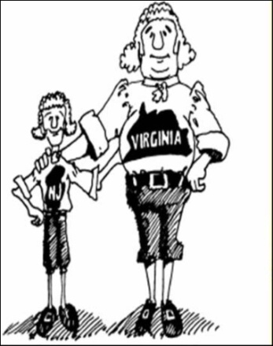
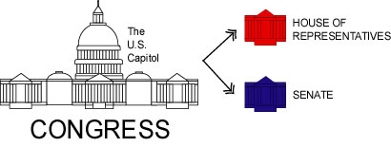
The Great Compromise
  A major debate at the convention was over how to set up Congress - the legislative branch of the government. It became a battle between the smaller states and the larger states.
  b. Several states submitted plans for the type of legislature they wanted.
i. The Virginia Plan (introduced by Edmund Randolph and James Madison) wanted the legislative branch to have two houses. Both houses would assign representatives based on wealth and population.
ii. The New Jersey plan (introduced by William Paterson) wanted the legislative branch to have one house. Each state would have only one vote.

Slide 16
The Great Compromise
58. The Great Compromise was presented to the convention by Roger Sherman, a delegate from Connecticut, on June 29, 1787. 59. This plan combined pieces of the Virginia Plan and the New Jersey Plan. 60. It called for two chambers of the legislative branch, just as the Virginia Plan did. 61. However, the size of both chambers being decided by population, as the Virginia Plan called for, was not instituted. 62. The Great Compromise instead called for one chamber where its size was based on population, and one chamber that had a fixed number of representatives per state, regardless of population. 63. A census would be taken every ten years to determine the number of seats in the population-based chamber. 64. Two seats were given in the fixed chamber to every state. 65. This plan would also include the three branches of government (executive, judicial, and legislative) that were called for in both the Virginia Plan and New Jersey Plan. 66. The Great Compromise was passed by one vote on July 16, 1787.
Skill - Independent
COMPROMISE – to settle differences by each side making concessions (giving in a little) to come to a solution that solves the problem.

Slide 17
The Great Compromise
c. The Great Compromise (proposed by Roger Sherman) took a little from both plans and agreed on setting up the legislature with two houses.
The House of Representatives would be based on population. Each state would get one representative for each 650,000 people living in the state. Originally one for every 40,000.
The Senate would be based on equality. Each state no matter how small or large would have two senators.

Slide 18
Closure
What was the biggest argument between the Virginia and New Jersey Plans?
How did the delegates solve their disagreements over how Congress should be set-up?

